Slide 1
Group assignment
Group “Empty”
Member: Yue Zheng, Zeran wang, Tianyi Mao, Dehong Xiao

Slide 2
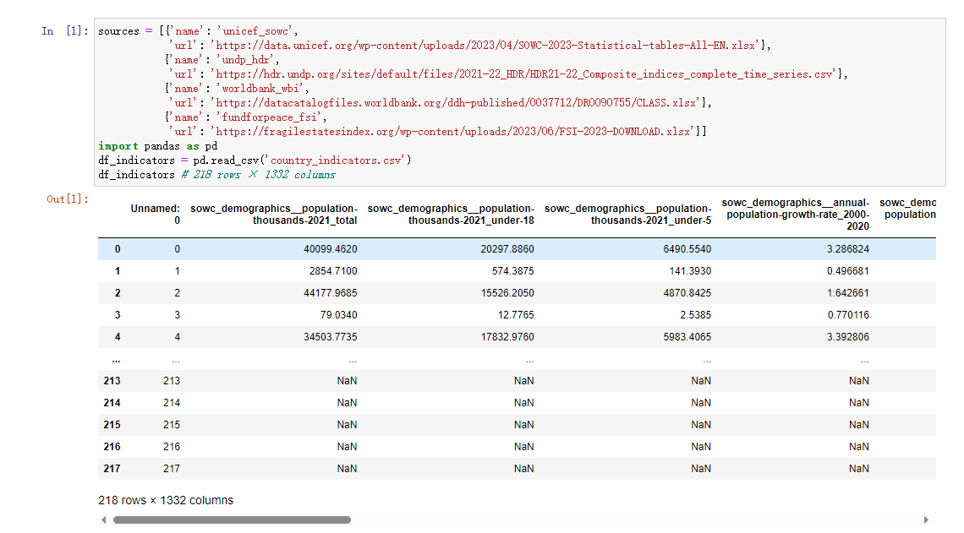
Input the original file ”country_indicators.csv”

Slide 3
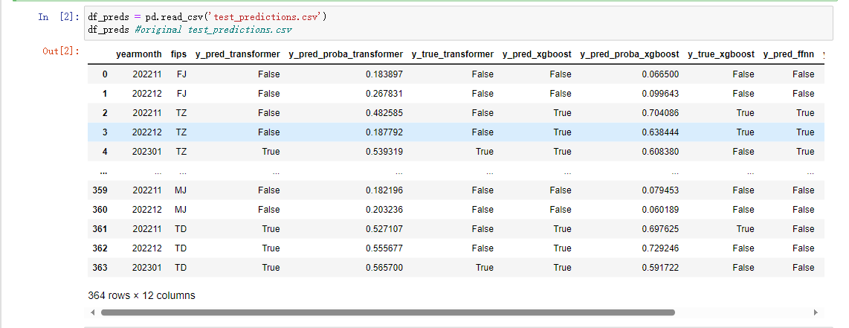
Input the original file ” test_predictions.csv”

Slide 4
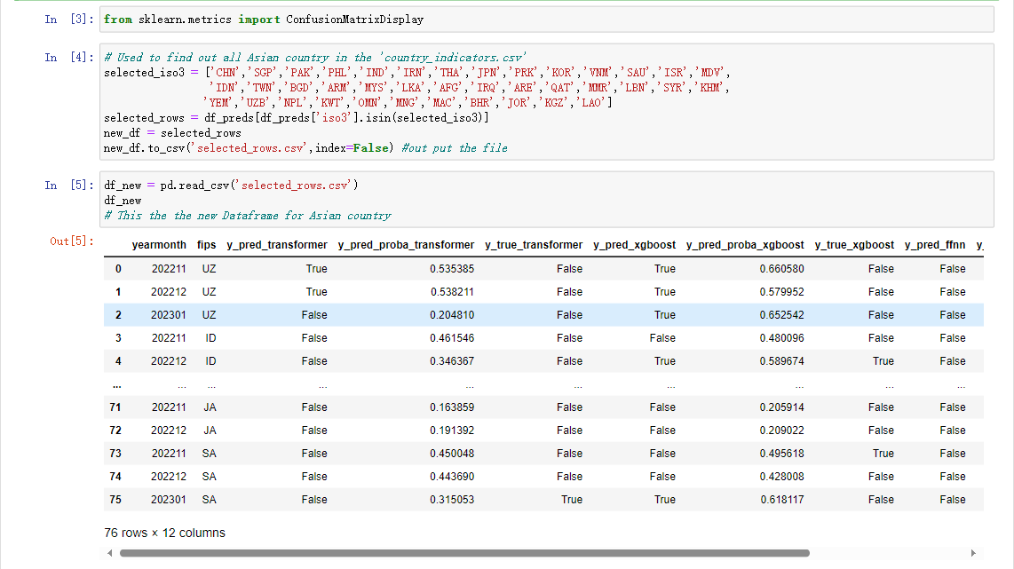
Selecting the country we want

Slide 5
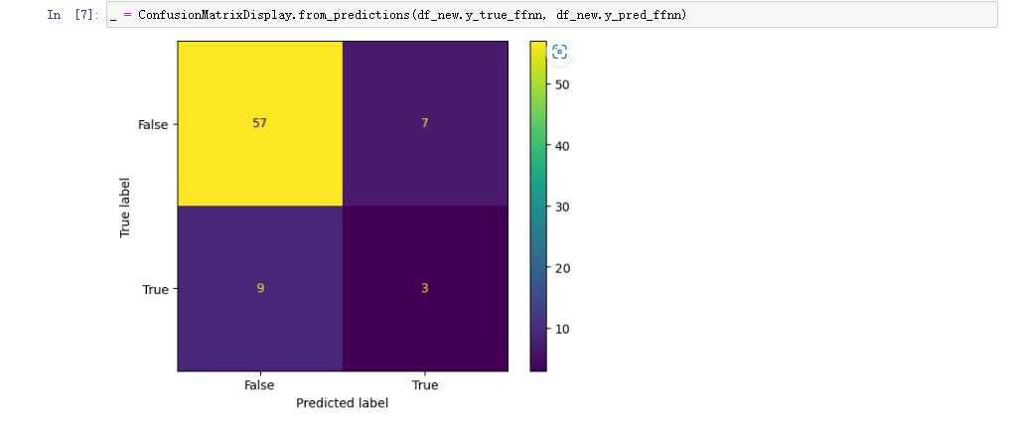
The graph with default value

Slide 6
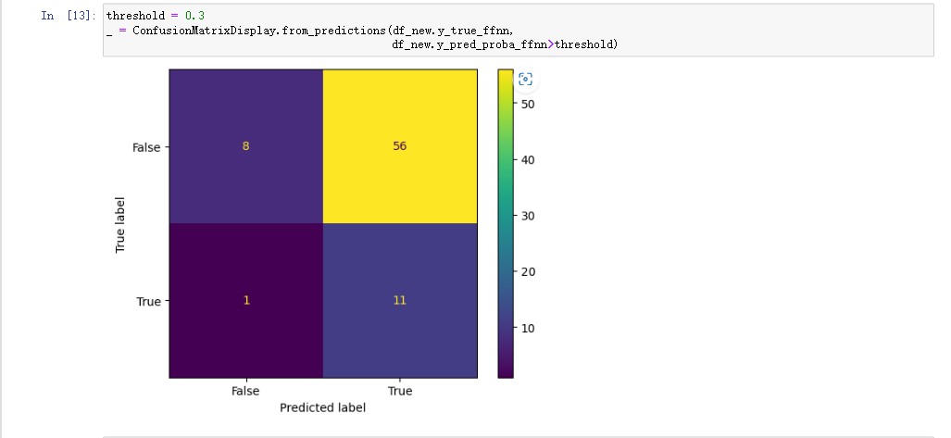
The graph with threshold = 0.3

Slide 7
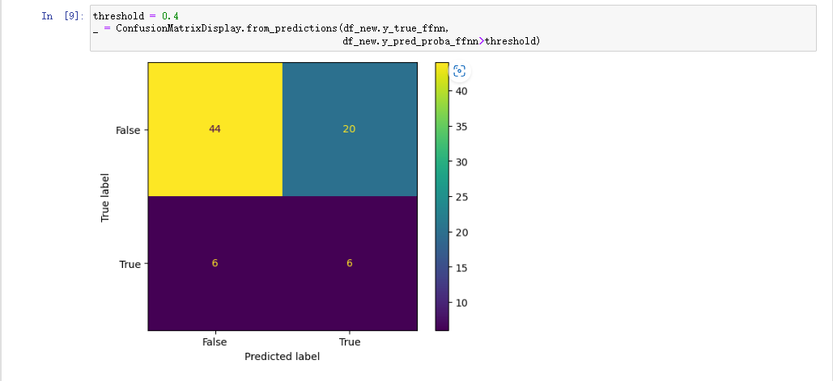
The graph with threshold = 0.4

Slide 8
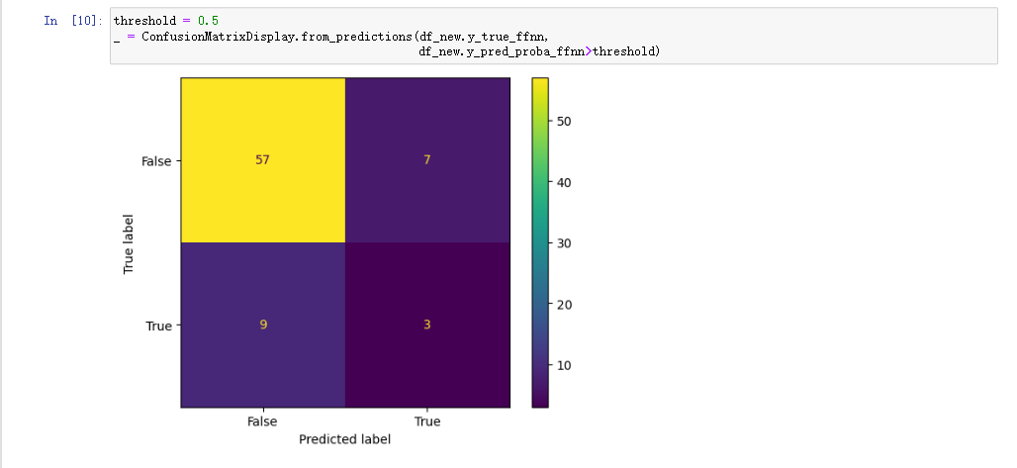
The graph with threshold = 0.5

Slide 9
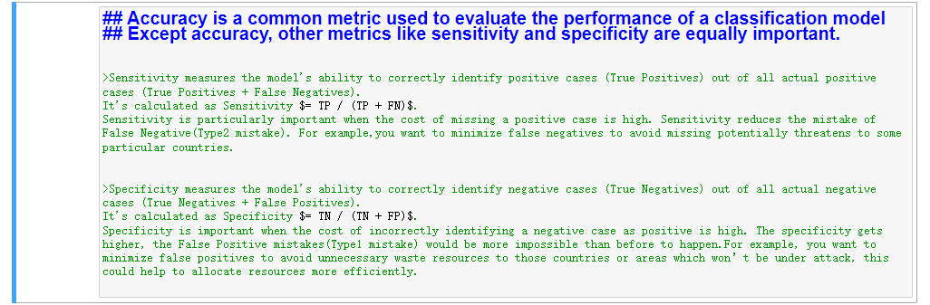
The data analysis for Three concepts

Slide 10
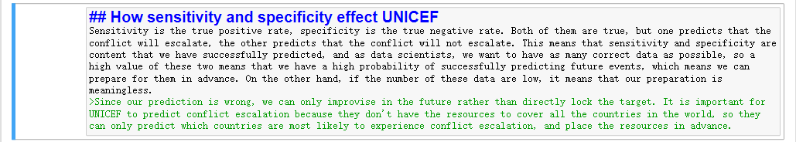
How these influence UNICEF

Slide 11
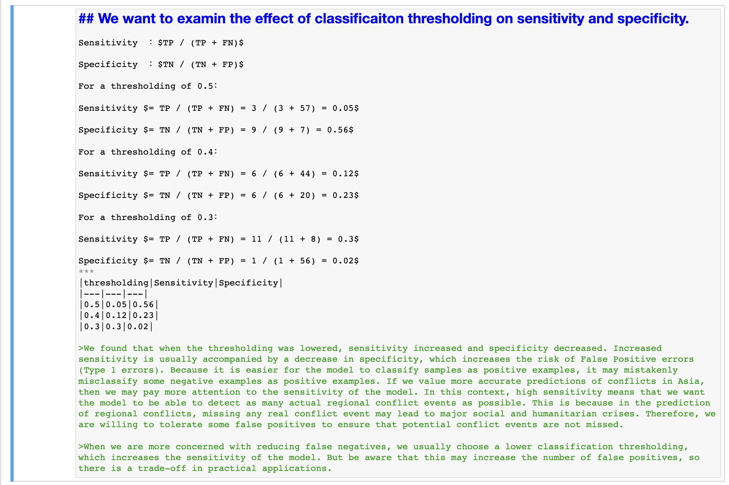
The effect of threshold

Slide 12
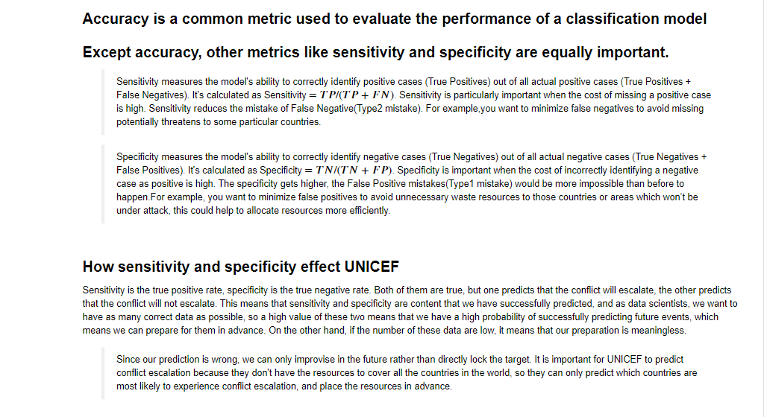
The final expression of analysis:

Slide 13
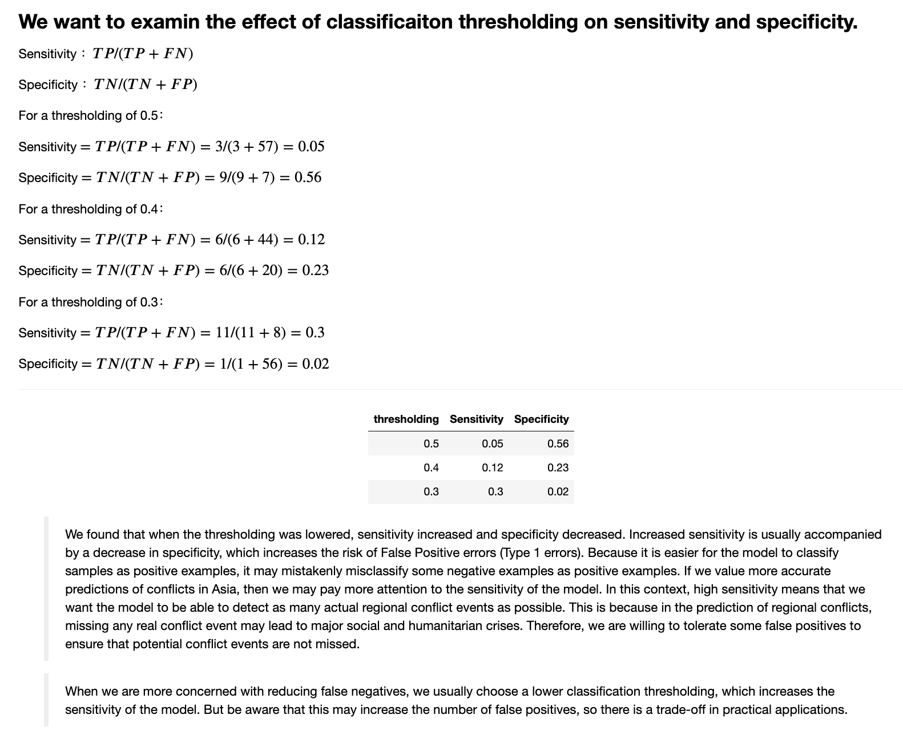
The final expression of analysis:

